Slide 1
Ch-04 Networking Basics Marks:10
Prepared by :
Prof. Biradar R.Y.

Slide 2
Socket
A socket is one endpoint of a two-way communication link between two programs running on the network.
A socket is bound to a port number.
Port is represented by a positive (16-bit) integer value.
Sockets provide the communication mechanism between two computers using TCP/IP.
Socket is a combination of an IP address and a port number.
2

Slide 3
Protocol
A protocol is a set of rules basically that is followed for communication.
IP (Internet Protocol): Low level routing protocol. Divides data into small packets and send on given address. It does not guarantee to deliver the packets.
Transmission Control Protocol (TCP): Higher level protocol. Reliability to deliver data. Connection oriented protocol.
User Datagram Protocol (UDP): Next to TCP. It support fast, connectionless, unreliable transport of data packets.
3

Slide 4
Transmission Control Protocol (TCP)
Example: HTTP, FTP, and Telnet.
User Datagram Protocol (UDP):
Example:Clock server and Ping.
4

Slide 5
Difference Between TCP & UDP
TCP | UDP
Connection oriented | Connectionless
Reliable | Unreliable
Retransmit | No retransmission
Slower data transmission | Faster data transmission
Require more cost | Less cost than TCP
Gives acknowledgement | No acknowledgement
TCP header size is 20 bytes. | UDP Header size is 8 bytes.
TCP is heavy-weight. | UDP is lightweight.
TCP is used by HTTP, HTTPs, FTP, SMTP and Telnet | UDP is used by DNS, DHCP, SNMP, RIP
5

Slide 6
IP Address
number identifying of a computer on the Internet
unique number assigned to a node of a network
range from 0 to 255.
Known as logical address
Can be changed
IP Address Classes
Class A : 1 to 126
Class B : 128 to 191
Class C : 192 to 223
Class D : 224 to 239
Class E : 240 to 254

Slide 7
IP Address
Ranges 127.x.x.x are reserved for the loopback or localhost,
for example, 127.0.0.1 is the loopback address.
Range 255.255.255.255 broadcasts to all hosts on the local network.
IP address: 2 version
IPv4 : 32–bits and in decimal (Now)
IPv6 : 128-bits and in hexadecimal (Future)

Slide 8
Port
used to uniquely identify different applications
acts as a communication endpoint between applications.
associated with the IP address for communication between two applications.
Port is of 16-bit address.
8

Slide 9
Reserved Ports
Ports are used to identify right application.
IP address is used to identify right computer.
Port number range : 0 to 65535
1024 ports are reserved.
Port numbers between 0 and 1,023 are reserved for standard services, such as email, FTP, and HTTP.
Protocol | Reserved Port
FTP | 21
Telnet | 23
SMTP | 25
HTTP | 80

Slide 10
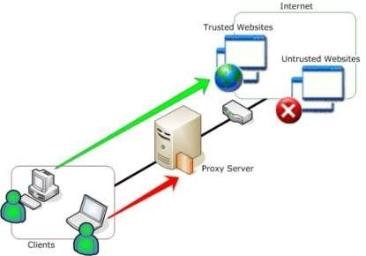
Proxy Server
It is mediator between real web server and
a client applications like web browser.
Mr. Nilesh Vishwasra

Slide 11
Features of Proxy Server
Filters specific request
stores data in catche for future use
Improving performance
Provides security
monitoring
Mr. Nilesh Vishwasra

Slide 12
Socket Programming
A socket is one end-point of a two-way communication link between two programs running on the network.
Socket is combination of an IP address and a port number.
Socket classes are used to represent the connection between a client program and a server program.

Slide 13
Socket Programming
can be connection-oriented or connection-less.
Connection Oriented
Socket
ServerSocket
Connection less
DatagramSocket
DatagramPacket

Slide 14
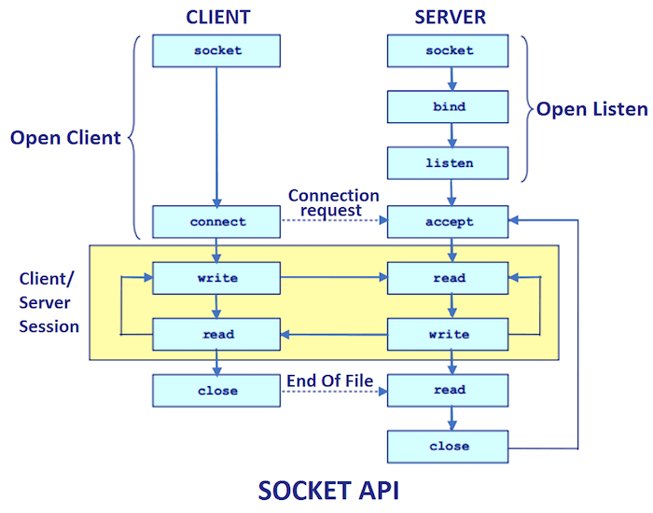
Server-Client Communication

Slide 15
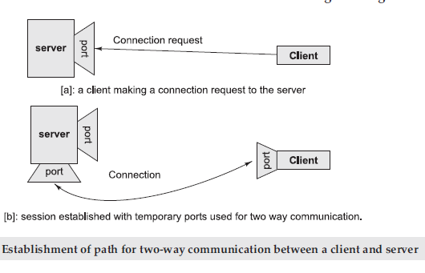

Slide 16
Socket Programming with TCP
Supports Connection-oriented ,reliable, bidirectional and stream based communication
initial handshaking phase
The package java.net provides support for
sockets programming.
import java.net.*;
Contains classes and interfaces to encapsulate the “Socket” Paradigm.

Slide 17
Classes & Interfaces from java.net package
InetAddress
Socket
URL
URLConnection ServerSocket DatagramSocket DatagramPacket

Slide 18
InetAddress class
Represents IP address
IP address is represented by 32-bit or 128-bit
InetAddress class is encapsulate both numeric IP address (eg .74.125.236.88) and the domain name (eg. www.google.com) for the address.
For example, mostly every internet user don't know IP address for google.com
13

Slide 19
About InetAddress class
InetAddress Class has no visible constructors. to create a InetAddress object.
Factory Method is used to create objects.
Three factory methods:
static InetAddress getLocalHost()
static InetAddress getByName(String hostName)
static InetAddress[] getAllByName(String
hostName).
All methods generate : UnknownHostException

Slide 20
Instance Methods
boolean equals(Object other)
byte[] getAddress(): Return four element of
IP address.
String getHostAddress(): Return host address associated with InetAddress.
String getHostName(): Return host name.
boolean isMultiCastAddress()

Slide 21
URL
URL is Uniform Resource Locator.
It is used to recognize resource on the internet.
It points to a resource on the World Wide Web
Network resource could be text, documents,
plain web pages, programs or graphics.

Slide 22
URL
URL string consist of following parts:
protocol
Host name or address
Port number
File or resource location.

Slide 23
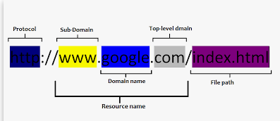
http://www.msbte.com:80/index.html

Slide 24
Exapmle:
http://www.msbte.com:80/index.html
Protocol: http is the protocol.
Host name or IP Address: www.msbte.com is the host name.
Port Number: It is an optional attribute.
80 is the port number.
If port number is not mentioned in the URL, it returns -1.
File Name or directory name: index.html is the file name.

Slide 25
URL
Ex
http://www.msbte.com/index.html
URL class has some constructors and it throws MalformedURLException
URL(String url)
URL(String protocol, String hostname, int port, String path)
URL(URL obj, String url)

Slide 26
Methods of URL
Method | Description
String getProtocol() | It returns the protocol of the URL.
String getHost() | It returns the host name of the URL.
int getPort() | It returns the port number of the URL. If port number is not mentioned in the URL, it returns -1
String getFile() | It returns the file name of the URL.
URLConnection openConnection() | It returns the instance of urlconnection i.E. Associated with this URL.
String toExternalForm() | Returns the string representation of a specified URL

Slide 27
import java.net.*;
public class URLDemo
{
public static void main(String[] args)
{
try
{
URL url=new URL("http://www.msbte.org.in/index.html");
System.out.println("Protocol: "+url.getProtocol());
System.out.println("Host Name: "+url.getHost());
System.out.println("Port Number: "+url.getPort());
System.out.println("File Name: "+url.getFile());
}
catch(Exception e)
{
System.out.println(e);
}
}
}
Output
Protocol: http
Host Name: msbte.org.in
Port Number: -1
File Name: /index.html

Slide 28
URLConnection Class
URLConnection is an abstract class
Used for accessing the attributes of remote
resource.
public URLConnection openConnection()throws
IOException{ }
openConnection() of URL class returns the object of URLConnection class.

Slide 29
URLConnection Class methods
int getContentLength() : Return size of contents related to resource. If no length then return -1.
String getContentType(): Return type of
content of resource.
long getDate() : Return date and time of response
long getLastModified() : return last date and time modified of response

Slide 30
URLConnection Class methods
long getExpiration(): Return expiration date
and time in miliseconds.
InputStream getInputStream() : Used to get contens of resource.

Slide 31
import java.net.*;
import java.util.*;
import java.io.*;
public class UCDemo
{
public static void main(String[] args)
{
try
{
URL url=new URL("http://www.javatpoint.com/java-tutorial");
URLConnection uc=url.openConnection();
System.out.println("length: "+uc.getContentLength());
System.out.println("date of response: "+ new Date(uc.getDate()));
System.out.println("date of last modification: "+new Date(uc.getLastModified()));
System.out.println("content type: "+uc.getContentType());

Slide 32
InputStream in=uc.getInputStream();
int c;
while((c=in.read())!=-1)
{
System.out.print((char)c);
}
}
catch(Exception e)
{
System.out.println(e);
}
}
}

Slide 33
Socket Class
implements one side of a two-way connection
Used to create client sockets, is designed to connect to server socket and initiate protocol exchanges.
Socket is implemented at the client side to send request to the port of the machine where ServerSocket is listening.
When Socket object is created, it establishes the connection b/w client and server.

Slide 34
Socket Class
Constructors:-
Socket(String hostname, int port) Socket(InetAdrress ipaddr, int port)
First argument is Hostname or IP address of Server.
Second argument is TCP Port.

Slide 35
Socket Class Methods
InetAddress getInetAdress()
int getPort()
int getLocalPort()
InputStream getInputStream()
OutputStream getOutputStream()
void close()

Slide 36
ServerSocket Class
Used to create server sockets
ServerSocket is implemented at the server side so that it can listen to the client’s request and respond to them
Constructors:-
ServerSocket ( int port )
ServerSocket ( int port, int queueLength)
ServerSocket ( int port, int queueLength,
InetAddress localAddr)
Method:-
Socket accept() : accept() is a blocking call that waits for a client to initiate communication and returns a normal Socket, that is used for communication with the client.

Slide 37
steps for creating a simple server program are:
1) Open the Server Socket:
ServerSocket server = new ServerSocket( PORT );
2) Wait for the Client Request:
Socket client = server.accept();
3)Create I/O streams for communicating to the client
DataInputStream receive= new DataInputStream(client.getInputStream());
DataOutputStream send= new DataOutputStream(client.getOutputStream());
4)Perform communication with client
Receive from client:
String line = receive.readLine();
Send to client:
send.writeBytes(“Hello\n”);
5)Close socket:
client.close();

Slide 38
steps for creating a simple client program are:
1)Create a Socket Object:
Socket client = new Socket(server, port_id);
2)Create I/O streams for communicating with the server.
receive = new DataInputStream(client.getInputStream());
send = new DataOutputStream(client.getOutputStream());
3)Perform I/O or communication with the server:
Receive data from the server:
String line = receive.readLine();
Send data to the server:
write.writeBytes(“Hello\n”);
4)Close the socket when done:
client.close();

Slide 40
Socket Programming with UDP
Connectionless and unreliable service.
There isn’t an initial handshaking phase.
Doesn’t have a pipe. No streams are attached to the sockets.
transmitted data may be received out of order, or lost
Datagrams are bundles of information passed between machine.
Datagram communication through Two classes
DatagramPacket
DatagramSocket

Slide 41
DatagramPacket
Data container
Each packet contains
InetAddress
Port of destination
Data
Constructor:
For Receiving data
DatagramPacket(byte data[],int size)
DatagramPacket(byte data[],int offset, int size)

Slide 42
For Sending data
DatagramPacket(byte data[],int size, InetAddress ipAddr,int port)
DatagramPacket(byte data[],int offset, int size,InetAddress ipAddr, int port)
Data in packet represented as byte array

Slide 43
Methods of DatagramPacket
InetAddress getAddress() –destination InetAddress
byte []getData() -used to retrieve data
int getLength()
int getPort()
void setData(byte[] buf)
void setAddress(InetAddress a)
void setPort(int port);
void setLength(int length)

Slide 44
DatagramSocket Class
Create UDP socket
Does not distinguish server / client sockets
Constructor specifies InetAddress, port
Set up UDP socket connection
no guarantee of its content, arrival or arrival time.
connection-less socket for sending and receiving datagram packets.

Slide 45
Constructor
DatagramSocket() throws SocketException
DatagramSocket(int port) throws SocketException
DatagramSocket(int port, InetAddress address) throws SocketException:
Methods
void receive( DatagramPacket p)
void send( DatagramPacket p)
void close()

Slide 46
Security with Java
Java Security API is a framework for implementing and using security measures in the Java environment
Java Security API is included in java.security package
java.security provides the classes and interfaces for the security framework.
Java applications have no security manager
Java applets have a strict security manager.

Slide 47
Permission | handles concerns related to accessing of system resources.
AllPermission | All other permissions are provided to the entity. It is subclass of Permission class
BasicPermission | It is the parents class for all the permission classes
FilePermission | Used to gives rights to local files/directories. It is subclass of Permission class
SocketPermission | Used to gives rights to local files/directories. It is subclass of Permission class

Slide 48
Policy | Determine whether the code being executed by the JVM has required permission to access the security policies.
Security | All the security related concerns and the specific properties are provided by this class.

Slide 49
Permission class
Permission classes represent access to various system resources such as files, sockets and so on.
Permission classes represent approvals, but not denials.
Permissions granted also called "privileges“
Permissions Consist of
Type
e.g. java.io.FilePermission
Name
e.g. name of file
“displaytext”
Action
read file, write file, delete file

Slide 50
FilePermission
Subclass of Permission class
Gives rights to local files/directories.
Rights set : read,write,execute,delete

Slide 51
SocketPermission
Subclass of Permission class
Host.
Local Machine: "local host."
Given machine: IP address or hostname.
Actions: accept,connect,listen,resolve.

Slide 52
Policy Class
Policy Class
Determine whether the code being executed by the JVM has required permission to perform security sensitive operations
Specify which permission applies to which code source.
Only a single instance of policy class can be installed in the virtual machine at any one time.

Slide 53
Policy Class
A Policy object can be installed by calling the setPolicy() method.
The installed Policy object can be obtained by calling the getPolicy()method.

